Slide 1
Urban Sound Classification Unsupervised Learning Capstone Project

Slide 2
Project analysis slide 2
URBAN SOUND
CLASSIFICATION
FINAL THOUGHTS
URBAN SOUND DATA SET
CAPSTONEPROJECT
CLUSTER EVALUATION
EXPLORATORY DATA ANALYSIS
CLUSTER ANALYSIS
PREPROCESSING

Slide 3
Project analysis slide 3
PROJECT DESIGN
INTRODUCTION
EDA
PREPROCESS
CLUSTER ANALYSIS
CLUSTER EVALUATION
Sonic event classification is a field of growing research.
Most of these researches focuses on music or speech recognition.
Scarce works on environment sounds.
Very few databases for labeled environment audio data.
.
Urban Sound 8k Dataset contains 8723 audio excerpts in .wav formats from 10 classes of different sound sources
We identified audio files with duration < 1 sec.
Great variation across audio samples.
Our biggest challenge is feature extraction.
Audio data cannot be expressed in vector forms like other type of data such as images and texts.
Applied various feature extraction techniques.
Most common method in Unsupervised Learning to group unsorted information.
Various methods to find the optimal number of clusters:
Elbow
Silhouette
AIC/BIC
Review various clustering algorithms.
KMeans
GMM
Spectral Clustering
Evaluate cluster performance metrics:
Adjusted Rand Index Score
Silhouette Score

Slide 4
Project analysis slide 4
IMPLEMENTATION
20-dimensional features.
Widely used in automatic speech and speaker recognition.
MFCC
KMeans
Mini Batch KMeans
KMEANS
128-dimensional features.
A pre-trained convolutional neural network.
CLUSTER EVALUATION
FEATURE EXTRACTION
VGG Embedding
Gaussian Mixture Model
Spectral Clustering
OTHERS
Librosa
Audioset
SKLearn.
Libraries

Slide 5
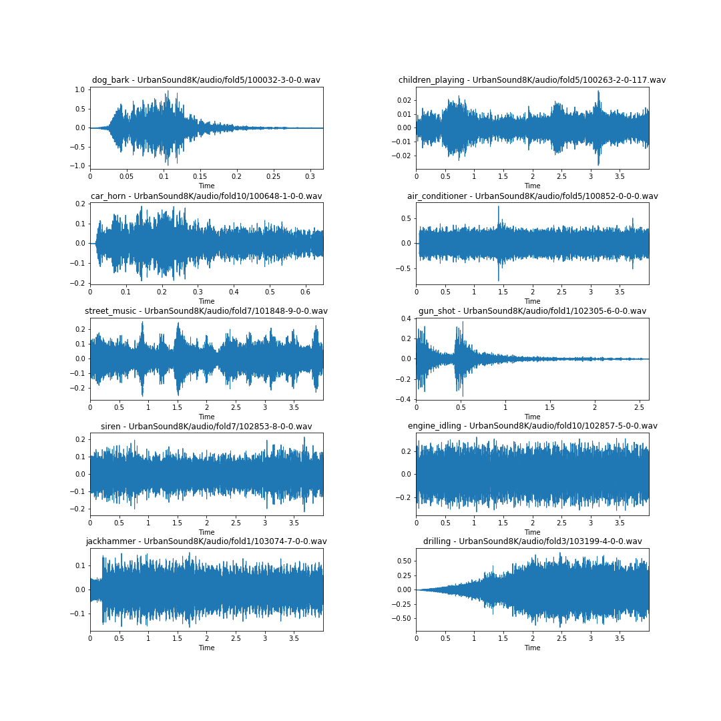
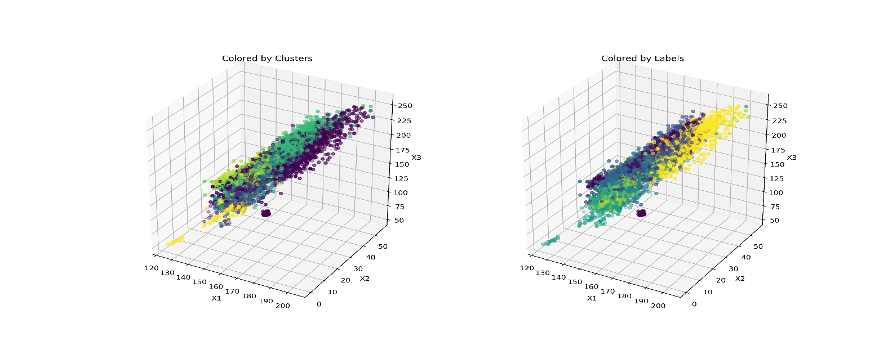
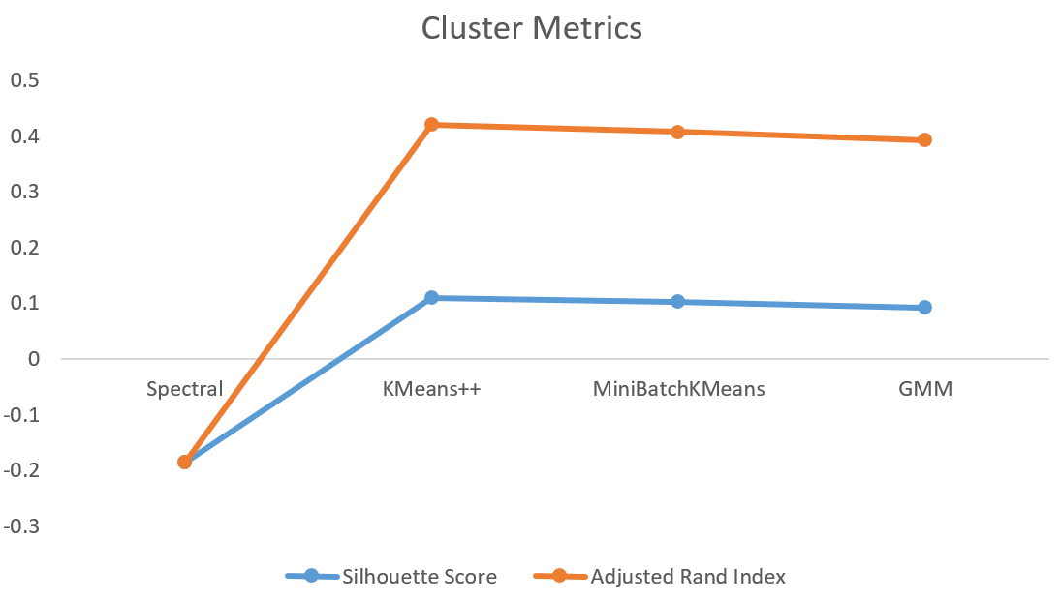
Project analysis slide 5
VISUALIZATIONS

Slide 6
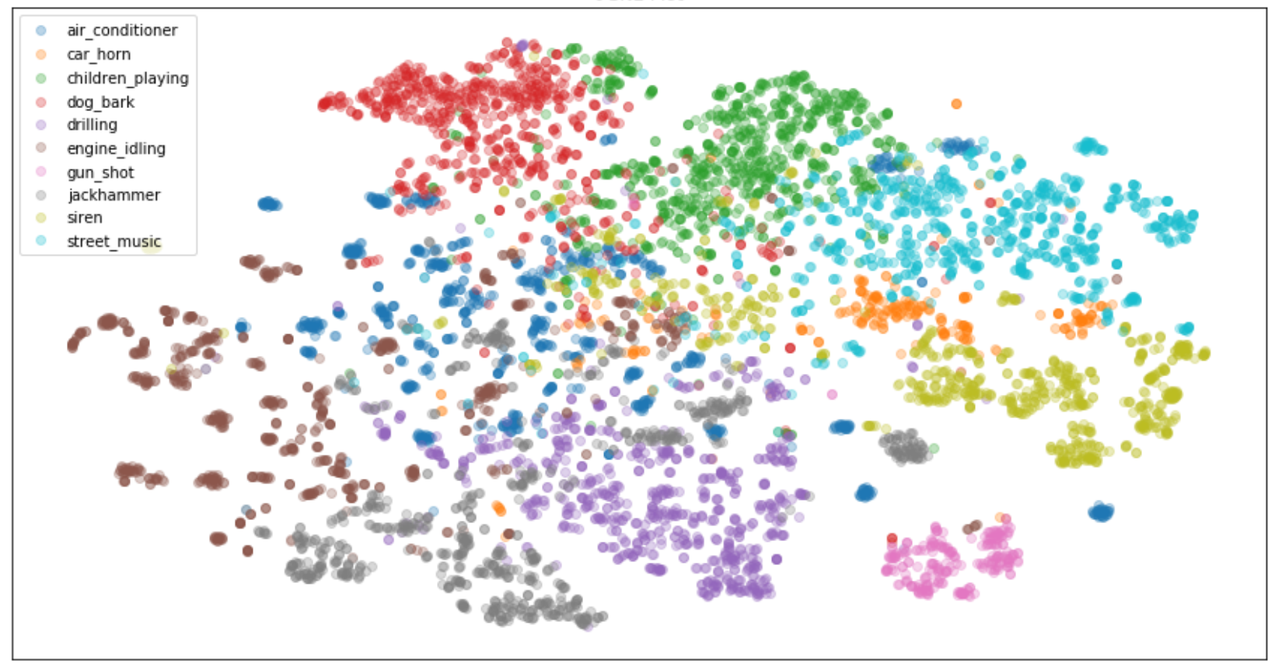
Project analysis slide 10
HIGHLIGHTS
We can see that our models is making the same types of mistakes that a human might: air conditioners for drilling and drilling for jack hammering.
Car horn and gun shot have less than 300 samples compare to other classes, which have around 1000 samples each.
Having the lowest number of samples, gunshot is still managed to have the highest proportion for true positive value. However, the car horn is often misclassified as the street music.
It is difficult to differentiate between jackhammer and drilling, however it is easy to discern between dog bark and drilling.

Slide 7
Project analysis slide 10
FINAL THOUGHTS
PRACTICAL USES
FUTURE CONSIDERATIONS
The automatic classification of audio events in an urban setting has a variety of applications. Some of them are listed below.
Audio Event Detection
Home security or Audio Surveillance
Assisted living, elder or infant care
Accident and crime surveillance
This capstone project focused on the unsupervised machine learning methods such as “Clustering” to draw inferences from datasets consisting of Unstructured Data without labeled responses.
Using Supervised Learning to model the data to give us predictive power to classify the sonic events accurately. Improving this model to encompass several different methods to optimize prediction of the audio classification. In addition to the modeling, one can also implement tensorflows, keras and neural networks.
We can potentially improve the quality of life of city dwellers by providing a data-driven understanding of urban sound and noise patterns, partly enabled by the move towards “smart cities” equipped with multimedia sensor networks.

Slide 8
Thank You

